Slide 1
EE227 – Digital Logic Design
Lecture 12

Slide 2
Outline
Exclusive OR (XOR) Function
Parity Generation and Checking
Quiz 2 Solution
Mid Term I Solution and Result

Slide 3
Exclusive OR Function (XOR)
The Exclusive-OR (XOR) is denoted by ⊕ and performs the following logical operation
A ⊕ B = AB’ + A’B
Exclusive NOR is complement of XOR
The following identities are true for XOR
A ⊕ 0 = A A ⊕ 1 = A’ A ⊕ A = 0
A ⊕ A’ = 1 A ⊕ B’ = A’ ⊕ B = (A ⊕ B)’
The XOR operation is commutative and Associative
A ⊕ B = B ⊕ A
(A ⊕ B) ⊕ C = A ⊕ (B ⊕ C) = A ⊕ B ⊕ C

Slide 4
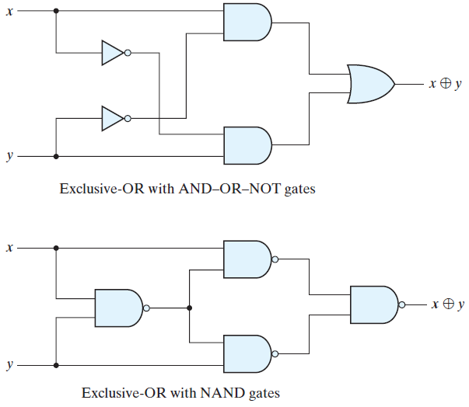
XOR with NAND Gates

Slide 5
XOR is an Odd Function
The output of XOR is equal to 1 if an odd number of inputs are equal to 1
For 2 inputs
A ⊕ B = AB’ + A’B = Σ(1, 2)
For 3 inputs
A ⊕ B ⊕ C = (AB’ + A’B)C’ + (AB + A’B’)C
= AB’C’ + A’BC’ + ABC + A’B’C
= Σ(1, 2, 4, 7)
For 4 inputs
A ⊕ B ⊕ C ⊕ D = (AB’ + A’B) ⊕ (CD’ + C’D)
= (AB’ + A’B)(CD + C’D’) + (AB + A’B’)(CD’ + C’D)
= Σ(1, 2, 4, 7, 8, 11, 13, 14)

Slide 6
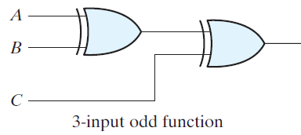
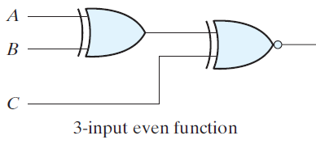
Even Function
The complement of XOR is an even function
For 2 inputs
(A ⊕ B)’
For 3 inputs
(A ⊕ B ⊕ C)’
For 4 inputs
(A ⊕ B ⊕ C ⊕ D)’

Slide 7
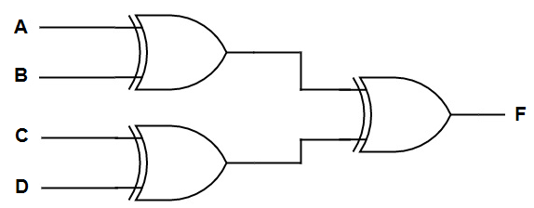
Practice Problem 1
Construct the circuit diagram for 4 input odd function

Slide 8
Parity Generation and Checking
Exclusive-OR functions are very useful in systems requiring error detection and correction codes
This is done with the help of a parity bit
The parity bit is an extra bit added to the original message to make the number of 1’s even or odd
Parity bit is added at MSB position
For example the message 011 0010 will be written as
1011 0010 with even parity and
0011 0010 with odd parity
The circuit that generates the parity bit in the transmitter is called a parity generator
The circuit that checks the parity in the receiver is called a parity checker

Slide 9
Parity Generator and Checker (1/3)
x,y, and z are inputs
For even parity the number of 1’s including Parity bit (P) must be even
P = x ⊕ y ⊕ z
For parity checker the inputs are x, y, z, and P and the output is 1 if the number of 1’s are odd, which means that an error has occurred
C = x ⊕ y ⊕ z ⊕ P

Slide 10
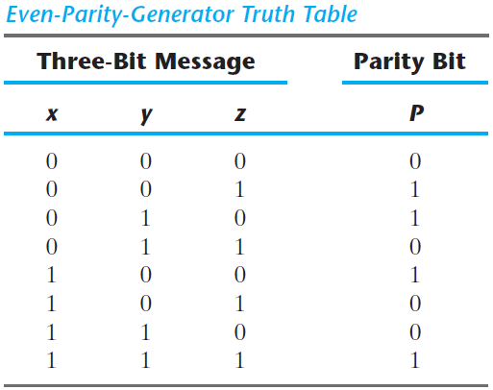
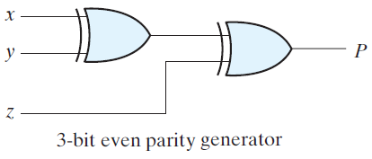
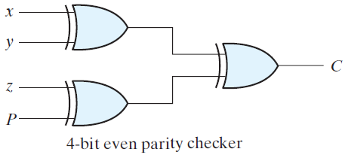
Parity Generator and Checker (2/3)

Slide 11
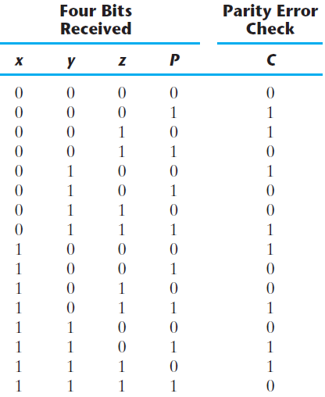
Parity Generator and Checker (3/3)
The parity generator can be implemented with the circuit of parity checker
This can be done by connecting the input P with the logic 0 and marking the output as P

Slide 12
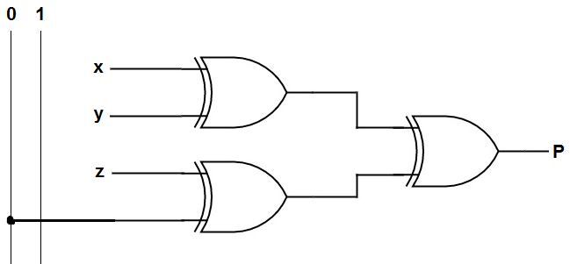
Practice Problem 2
Modify the circuit of 4 bit parity checker to convert it to a 3 bit even parity generator

Slide 13
Quiz 2
Solution

Slide 14
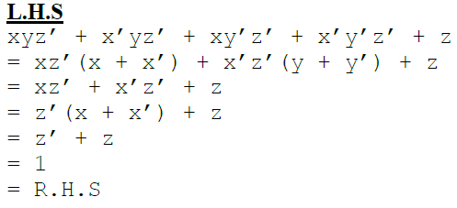
Quiz 2 (Paper A)
Question Number 1
Prove the following Boolean equation using Boolean algebra:
xyz’ + x’yz’ + xy’z’ + x’y’z’ + z = 1

Slide 15
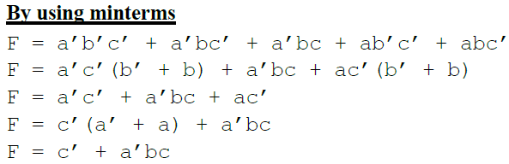
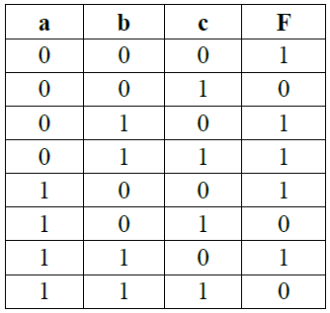
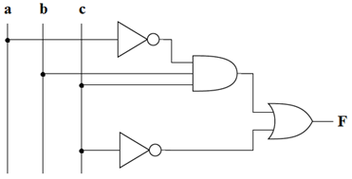
Quiz 2 (Paper A)
Question Number 2
Write the Boolean equation (in simplified form) and draw the logic diagram of the circuit whose output is defined by the following truth table.
Hint: Use minterms or maxterms

Slide 16
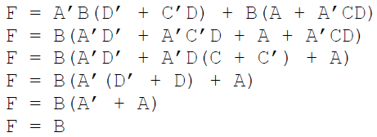
Quiz 2 (Paper B)
Question Number 1
Reduce the following Boolean expression to one literal.
A’B(D’ + C’D) + B(A + A’CD)

Slide 17
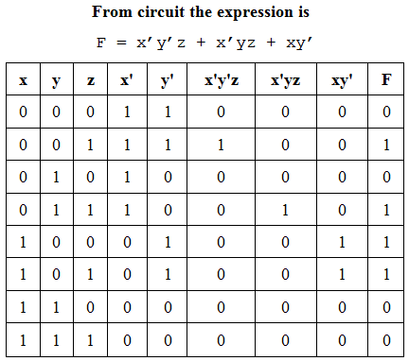
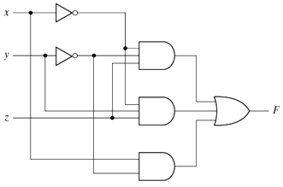
Quiz 2 (Paper B)
Question Number 2
For the given circuit, write the equivalent Boolean expression and construct the truth table

Slide 18
Mid Term I
Solution
Was Done in Class

